Slide 1
Information Distribution

Slide 2
Objectives
Identify one component or method of designing and delivering effective messages for different audiences.
Identify one way you could serve as a resource to the public, media or policy makers.

Slide 3
Identify & Differentiate the Components & Methods of Designing & Delivering Effective Messages for Different Audiences
Massive amounts & types of materials exist for messaging
  Don’t try to reinvent the wheel
Messages must meet certain criteria in order to be effective

Slide 4
Delivering effective messages for different audiences
Messages Must:
  Meet program objectives
  Fit audience learning style (visual, auditory)
  Present concepts in simple organized way
  Adapt to the culture, value, beliefs of the audience
  Show relevant photos and visuals to fit culture
  Written or narrated at the appropriate literacy level

Slide 5
Guidelines for developing & adapting materials for injury prevention
Text, Narrative
  Include only a few concepts
  Shorter sentences & words familiar to audience
  Quote credible people
Visuals
  Make clear and easy to understand/avoid complicated graphs
  Illustrate ONLY the desired behaviors, not the ones to be avoided
  Should reflect cultural/ethnic background of audience
Format
  Use only few concepts & pages
  Leave enough space between text & visuals
  Appropriate colors and font
Pretesting
  Use focus groups, interviews, and other reviews to help determine if acceptable

Slide 6


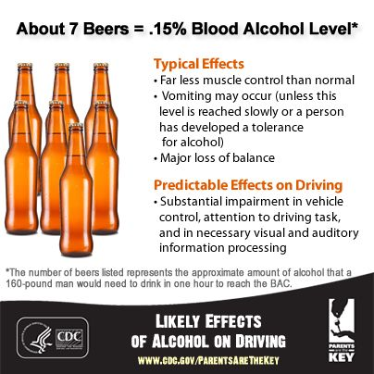
Examples of Injury Prevention Messages

Slide 7
Serve as a Resource for Public, Media, Policy Makers
The term “expert” carries credibility and prestige. Becoming an expert May include:
Have a book or book chapter published
Attend conferences and workshops
Read broadly on the topic
Network with recognized experts in the field.
Join and become active with related professional organizations
Present at a conference or workshop

Slide 8
Serve as a Resource for Public, Media, Policy Makers (cont.)
Once you have become accomplished or expert in the subject matter:
Write articles for newspapers or professional journals.
Speak as often as possible, in public settings, at conferences, advocating, and with the media.

Slide 9
Communication Skills
Written and verbal communication skills are the cornerstone of promoting injury prevention.
Skills will be honed through practice and as level of expertise grows.

